Slide 1
Career Development Boards
Notes:
Time Required: 55 min

Slide 2
Enabling Objectives
STATE the purpose and benefits of Career Development Boards (CDBs)
DESCRIBE CDB general discussion topics and types
LIST the CDB command and department level member responsibilities
STATE the purpose of the Individual Career Development Plan (ICDP)
DEMONSTRATE how to properly annotate career decisions and CDBs with CIMS
Notes:
FACILITATOR GUIDE
Review objectives.

Slide 3
References
OPNAVINST 1040.11F: Navy Enlisted Retention and Career Development Program
NAVPERS 15878N: Bureau of Naval Personnel Career Counselor Handbook
NAVPERS 1040/2: Career Information Program Review
Career Information Management System (CIMS) User Guide
MyNavy HR website:
  https://www.mynavyhr.navy.mil
Notes:
FACILITATOR GUIDE:
Review references.

Slide 4
Career Development Board
(CDB)
The primary delivery method to ensure Sailors and their families are provided necessary guidance to make informed career decisions based on current Navy policies, programs, and procedures.
“Career Development Boards are how we keep faith with our Sailors and their families. They turn intent into action – translating command priorities into a clear plan for training, qualifications, and advancement at every stage of a career. Done well, CDBs build confidence by giving Sailors predictable paths and honest timelines; they build competence by aligning skills, schools, and experiences to fleet needs; and they build character by holding leaders accountable for follow-through. Every board must end with a written plan, named owners, and dates – because if we can't write it down, it doesn't exist. CDBs are not paperwork; they are our method for growing self-sufficient warfighters and retaining talent. Make them rigorous, respectful, and results-driven."
John Perryman
17th Master Chief Petty Officer of the Navy
Notes:
FACILITATOR GUIDE:
It is imperative that CDBs are conducted at the command and department level to ensure each Sailor is afforded an opportunity to interact within their respective COC.
An effective CDB will provide the necessary guidance for the Sailors to make an informed career decision(s).

Slide 5
Career Development Board
Benefits
Provides all enlisted Sailors the opportunity for optimal development of professional skills
Enhances unit readiness
Encourages upward mobility
Improves job satisfaction
Enhances retention
Better informed and involvement between the Chain of Command and Sailor
Notes:
FACILITATOR GUIDE:
CDB’s are important to the commands structure. They can serve as a catalyst to motivate Sailors and show them that their goals and aspirations are important to their leadership.

Slide 6
Career Development Board
Topics
Familiarization with Sailor's history and background
Personal and professional goals (short and long-term)
Work/Family life balance
Introduce the CDT members
Advancement requirements/BBA
Rating or “A” school selection (PACT)
C-WAY /My Navy Assignment
Separation (career intermission, FLT RES, HYT etc.)
Navy Cool / USMAP
Career Path and Community Overview
Sea/Shore flow-PRD timelines
Education (TA, CLEP, DANTES, GI Bill, USNCC)
Reserve Affiliation-Separation Process
Mentorship / My Navy Coaching
Collateral Duties / Community involvement
Qualifications/ Warfare qualifications
Physical readiness/Medical readiness
Commissioning and special programs
Military Life Cycle
4-2-2
Incentives (SRB, AIP, SDIP, etc)
Financial Education/Well-being
Ensure to utilize the ICDP at all CDBs
Notes:
FACILITATOR GUIDE:
The topics listed are just sample talking points. Every CDB should be tailored around the Sailor goals and career path. Gathering insight prior to the board date will assist with the compiling your list of resources, briefing the board members and ensure the effectiveness of the CDB.

Slide 7
Career Development Board
Types
Command level CDB
  Reporting (within 60 days)
  PACT 18-month CDB to be conducted at the command level only if a Sailor has not been approved for rating designation
Department level CDB
  24, 48, 60, Biennial
  Professional Apprenticeship Career Track (PACT) at 6, 12, 18, and 24 months onboard
  Career Decisions
Notes:
FACILITATOR GUIDE:
A Sailor or chain of command can request a CDB at any point outside the mandatory window. For example: If a Sailor encountered a major life even and is now on the fence about making a career decision. A CDB would be beneficial to the Sailor to provide support and the necessary guidance needed to make an informed decision.
If desired, a Sailor or the chain of command can request a department level CDB to become a Command level CDB.

Slide 8
Career Development Board
Board members
  Department Level
    Department Leading Chief Petty Officer (DLCPO) (Chairperson)
    Department/Division CC
    Division Chief Petty Officer (CPO)
    Leading Petty Officer (LPO)
    As Required (ESO, Mentor, Ect)
Command Level
    CMC/COB/SEL (Chairperson)
    CCC
    As Required (ESO, Commissioning Coordinator, Mentor)
Notes:
FACILITATOR GUIDE:
The command CMC/COM/SEL can designate the DLCPOs (Chief or above) to chair command level CDBs as long as the CDBs is not their CDB. A Chair alternate can be assigned when necessary but must be designated in writing. The chairperson is responsible for controlling the flow and the focus by keeping everyone on track. By doing so, this will ensure the effectiveness of the CDB. Since each CDB is unique to the Sailor needs, the required board members will vary.

Slide 9
Career Development Board
Responsibilities
Board Chairperson
    Facilitate the CDB and keep all board members on track with the goals and objectives set for the Sailor
LCPO/LPO
    Ensure Sailors are afforded the opportunity to appear before a CDB
    Provide professional support to their Sailor
    Accompany Sailor to all appearances before CDB
Additional members
  ESO, Pay/Pers, Mentors, etc. are considered technical advisors who can provide information and resources during CDB’s and should be invited to attend
Notes:
FACILITATOR GUIDE:
The command CMC/COM/SEL can designate the DLCPOs (Chief or above) to chair command level CDBs a Chair alternate can be assigned when necessary but must be designated in writing.
The chairperson is responsible for controlling the flow and the focus by keeping everyone on track. By doing so, this will ensure the effectiveness of the CDB. Since each CDB is unique to the Sailors needs, the required board members will vary.
The ESO can be requested on a case-by-case simply because the information can be obtained from CIMS by the CCC or DCC.

Slide 10
Career Development Board
Responsibilities (cont.)
CCC/DCC
    Indoctrinate Sailors on CDB process
    Identify Sailors that require a CDB
    Schedule CDBs
    Disseminate CDB schedule (e-mail, POD, POW, etc.)
    Notify board members and Sailors of date, time, and location of CDB
    Document CDB members, minutes, recommendations, and approval or disapproval comments within CIMS
    Update Sailor career decision
    Provide Sailor with final ICDP
    Follow-up as needed
Notes:
FACILITATOR GUIDE:
None.

Slide 11
Career Development Board
Preparation
Location
    Suitable for private counseling
    Presentable and free from distractions
Documents
    CDB interview sheet / ICDP
    Last Eval (as applicable)
    Last advancement exam profile sheet (as applicable)
    My Navy Assignment Negotiation Table
    LaDR
    Rating community health slide
    Military Life Cycle (first term, mid-career, TAP)
    Any other supporting information to assist in achieving goals
Notes:
FACILITATOR GUIDE:
None.

Slide 12
Career Development Board
Execution
Find out what is important to the Sailor and their family
Get the Sailor engaged in a conversation
Be mindful of tone and delivery as CDBs should be positive in nature for the Sailor and not utilized for disciplinary discussions
Ensure discussion is focused and specific to the goals that the Sailor wants to achieve, then connect them to resources to achieve their goals
Keep privacy in mind
Ensure board members are briefed and ready for the CDB prior to beginning
Welcome them to the team, provide clear expectations and discuss how they support the command mission
Notes:
FACILITATOR GUIDE:
The goal of CDBs is to provide the appropriate guidance regardless of the Sailor career intentions.
Sailor's should be comfortable, have no fear of intimidation and retribution.

Slide 13

Career Development Board
S.M.A.R.T Goals
Specific
  Goals need to be clear, focused and concise.
Measurable
  Have a timeframe, dates, number, or amount to measure your success.
Action Oriented
  Goals require you to act!
Realistic
  Goals must be manageable and attainable.
Time-Driven/Timely
  Have a starting and ending point.
Notes:
FACILITATOR GUIDE:
Personal goal setting is no different than mission or objective planning within the military. All you need is a set of clear objectives that are well defined, measurable, realistic and time driven. SMART goals should be:
Written in positive terms
Posted in a prominent place so you can stay focused
Have to be your own
Be flexible, your situation and goals can and will change as life circumstances change.
When drafting your goals, think about the five “W’s”:
What do you want to accomplish?
Why is this goal important?
Who is involved?
Where is it located?
Which resources or limits are involved?

Slide 14
Career Development Board
S.M.A.R.T Goal example
Goal | To Save Money
S – specific | Save $10,000
M- measurable | By my PRD (July 2026)
A- action oriented | Set up allotment of $350.00 per month to go to savings Account
R- realistic | Is it manageable? YES (if No; change the end goal or the goal date)
T- time driven | Start allotment month: JAN 2024 End allotment month: JUL 2026
Result | $350.00 X 30 months = $10,500
Notes:
FACILITATOR GUIDE:
Any scenario can be utilize. Suggest using one that is relevant to your command and Sailors.

Slide 15

Learning and Development Roadmap
(LaDR)
LaDR
  https://www.cool.osd.mil
Notes:
FACILITATOR GUIDE:
Discuss the Enlisted Career Path and its importance in managing the career path of a Sailor.
Point out that billets on the right side of the document is something that they want to try to obtain and have it documented in their evaluations.

Slide 16
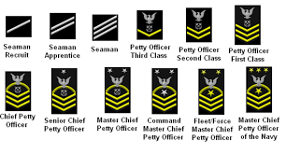
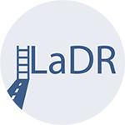
Learning and Development Roadmap
Enlisted Sailors' Career Continuum
Development Opportunities
Development Requirements
Primary Enlisted PME
E7
Navy Credentialing “COOL”
Advanced Leader Development (E6)
Basic Enlisted PME
TA/NCPACE
E5-E6
Block Learning / Advanced Technical Training
DANTES College Testing (CLEP & DSST)
KEYSTONE
Sailor 360
Intermediate Leader Development (E5)
Introductory Enlisted PME
E9
E4
Advanced Technical Training “C School”
CMC/COB
Department of Labor Apprenticeship (USMAP)
Foundational Leader Development
Advanced Education Voucher (AEV)
Senior Enlisted Academy
E1-E3
Fleet Seminar Joint
Professional Military Education
E8
Professional Qualifications
Online Academic Skills Program
Navy Senior Leadership Seminar
Chief Petty Officer Leader Development (CPO-LDC)
DEP
Technical Training “A School”
RTC
E7
Chief Petty Officer Initiation
Notes:
FACILITATIOR GUIDE:
Review Career Continuum chart. This is not all inclusive some steps on the development opportunities side can be completed sooner than later or vice versa.

Slide 17

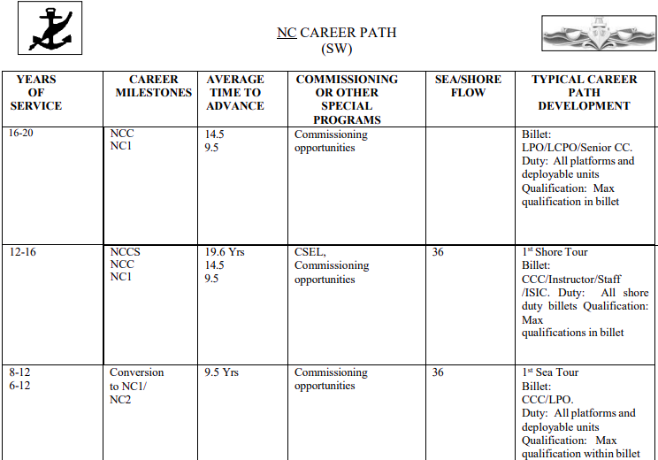
Learning and Development Roadmap
Enlisted Career Path
Notes:
FACILITATOR GUIDE:
Discuss the Enlisted Career Path and its importance in managing the career path of a Sailor.
Point out that billets on the right side of the document is something that they want to try to obtain and have it documented in their evaluations.

Slide 18
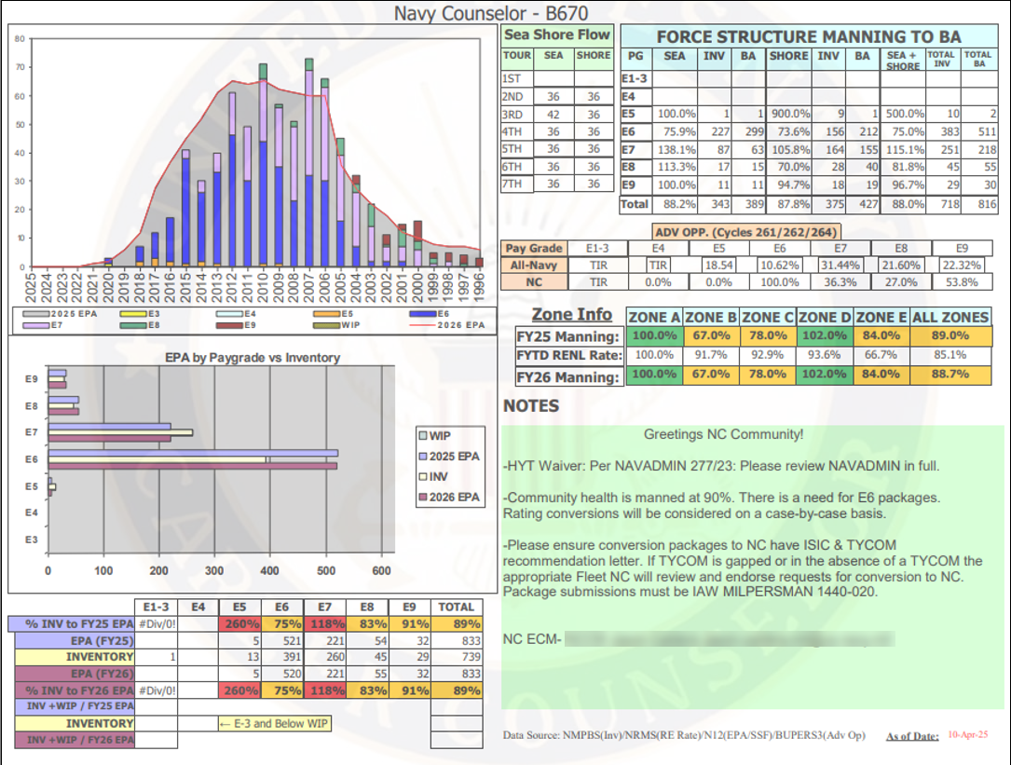
Enlisted Community Overview
(ECM Slide)
Notes:
FACILITATOR GUIDE:
1. Review the community health slide.
2. The community overview is a snapshot of the ratings overall health. This information is published monthly by the respective rating Enlisted Community Manager (ECM).
3. This slide can be utilized during CDBs for advancement and/or conversion interests.
The following data is provided:
Rating inventory (over manned, under manned, overall health percentage)
Advancement statistics
SRB notices “if applicable”
Conversion opportunity
RC2AC opportunities
Sea shore flow
ECM notes relevant to policies, growth/reduction as it relates to end-strength.

Slide 19
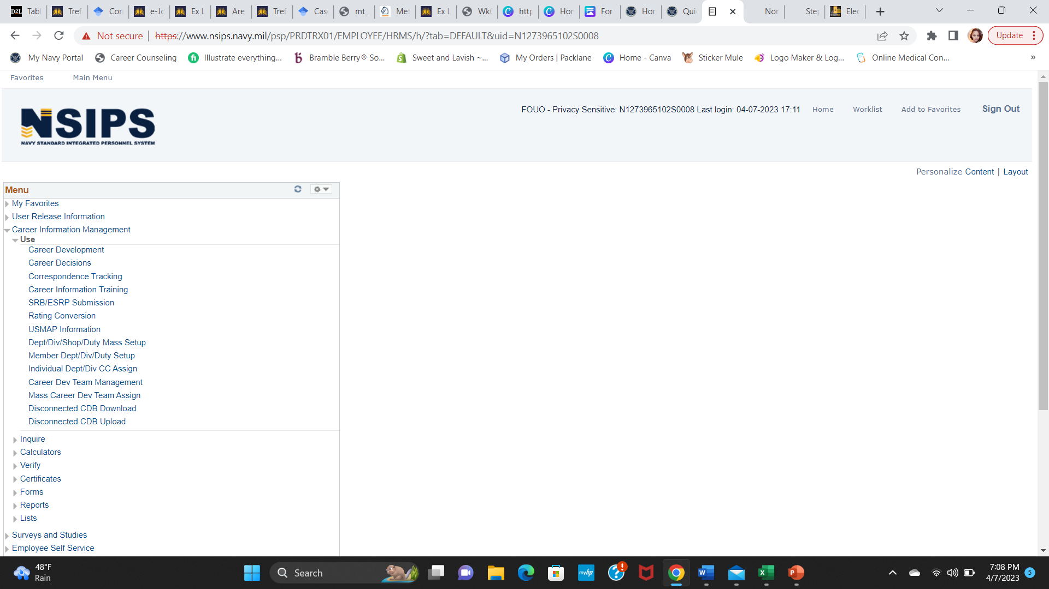
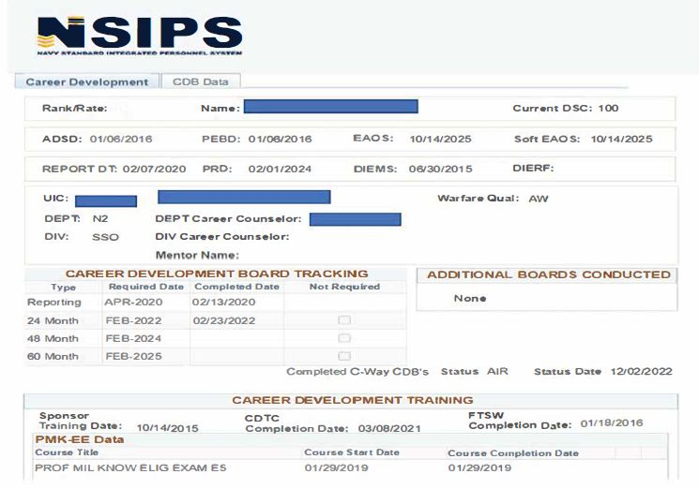
Career Development Board
Navy Standard Integrated Personnel System (NSIPS)
Tracking Info
Notes:
FACILITATOR GUIDE:
You can verify CDB completion and career development trainings here.

Slide 20

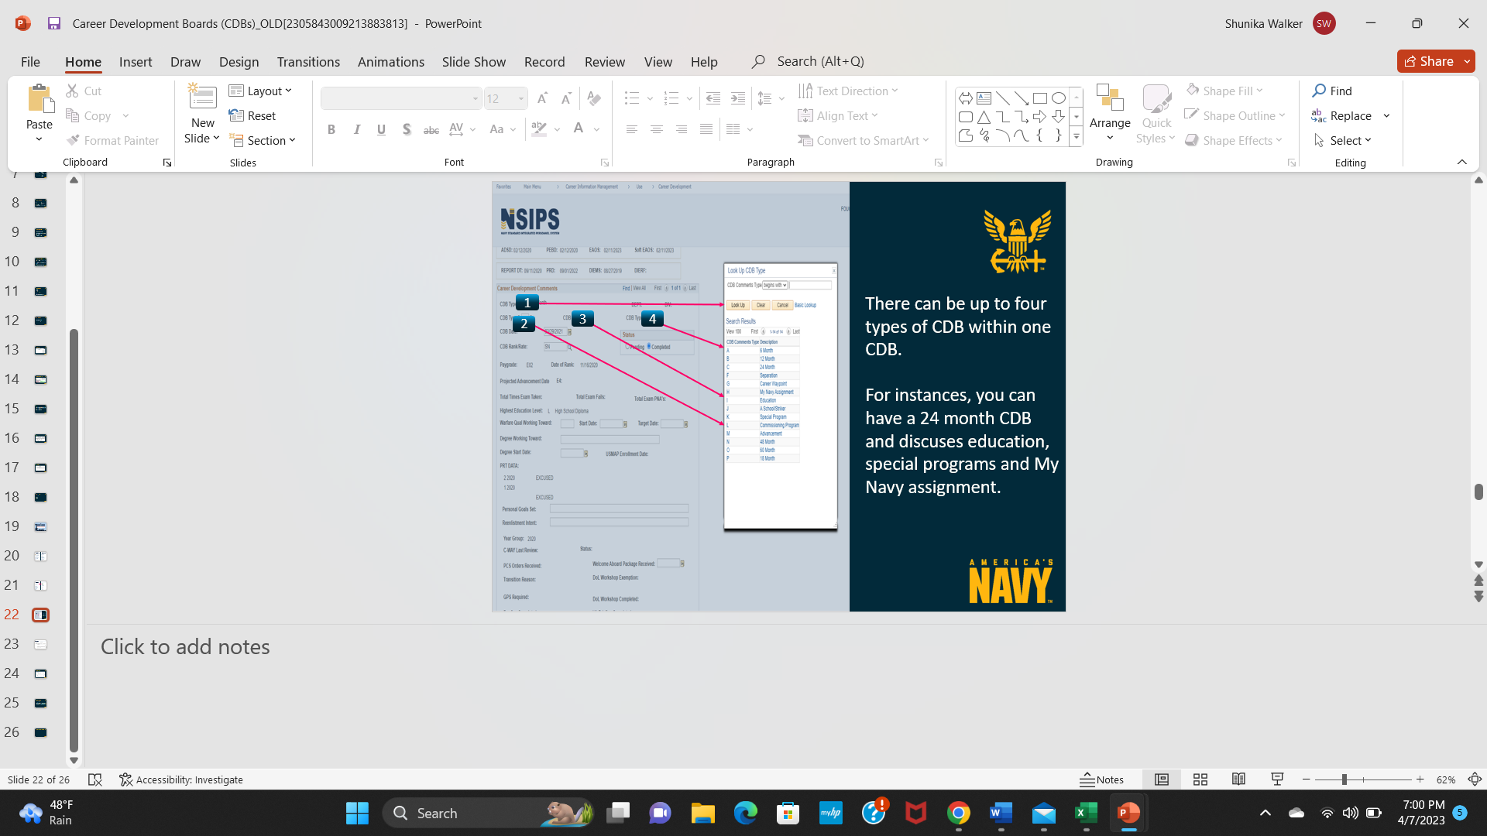
Career Development Board
Navy Standard Integrated Personnel System (NSIPS)
There can be up to four types during one board
For example, you can conduct a 24-month CDB in conjunction with CWAY, MNA and special program
Notes:
FACILITATOR GUIDE:
Career development boards are part of the Navy's effort to promote retention and maintain stable manpower levels. CDBs are designed to assist Sailors in making informed career decisions through available resources. It is important to capture the full picture of the meeting by being as detailed as possible. For instance, you want to make sure the reader is able to fully understand what took place and if the CDB was successful in conveying the right message to the Sailor.
Additional Notes:
Ensure short and long term goals are listed for every CDB.
Ensure ALL required board members are listed i.e. DLCPO, ACOS or Div Officer LCPO or Div CPO, LPO and DCC. Other member may attend depending on the CDB type such as mentor, special programs, ESO and so on.
In the board comments, make sure you annotated the type of CDB as well as list all board members followed by your notes.
Ensure you mark the CDB as complete (if completed) or pending (to work on later) and save. ICDP will be made available (below comments) to print after you save your info.
NOTE: The primary CDB is the first CDB type and will be displayed on the ICDP as such.

Slide 21
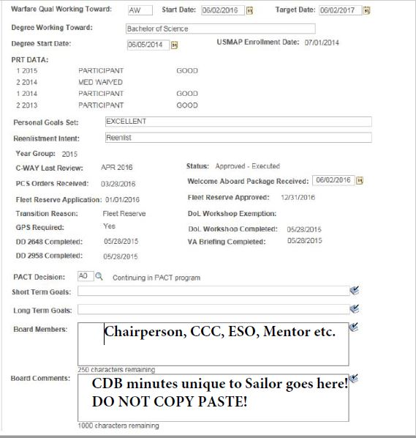
Career Development Board
NSIPS Entry
Notes:
FACILITATOR GUIDE:
Every CDB is unique. Please refrain from copy paste! Some general information i.e. CWAY, SEPARATION etc. may have similar components to enter in the CDB minutes but should not be identical because each Sailor has different goals.
CDBs should be one-on-one with chairperson and board members. NO MASS CDBs OF ANY KIND
CDBs are not considered completed until “verified”. Simply clicking “complete” and entering minutes does not complete the process of documentation.
Full and thorough details are located in “CIMS USER GUIDE” which can be access from: MyNavy HR<Career-Management<Career-Counseling

Slide 22
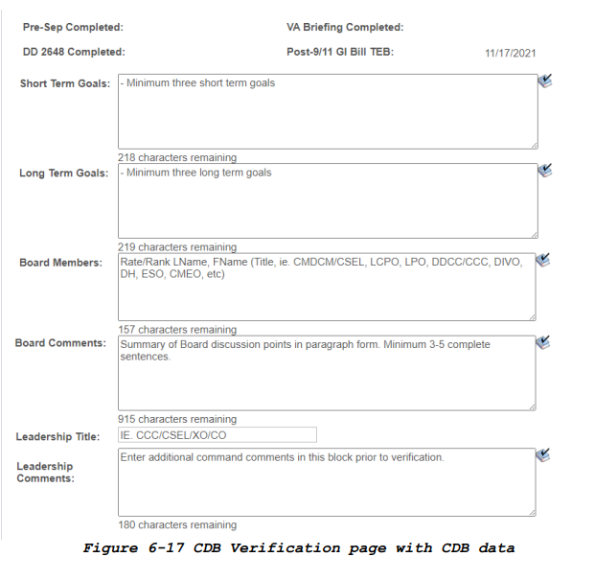
Career Development Board
Minutes
CDB minutes should be clear and capture the true intent of the of the board and information provided to the Sailor.
Note:
    Mass CDBs are not Authorized.
  Use titles for Board members.
Notes:
FACILITATOR GUIDE:
CDB minutes should be routed for final approval before being verified in CIMS.
Verified minutes should be routed with your monthly report and retained for 24 months.

Slide 23
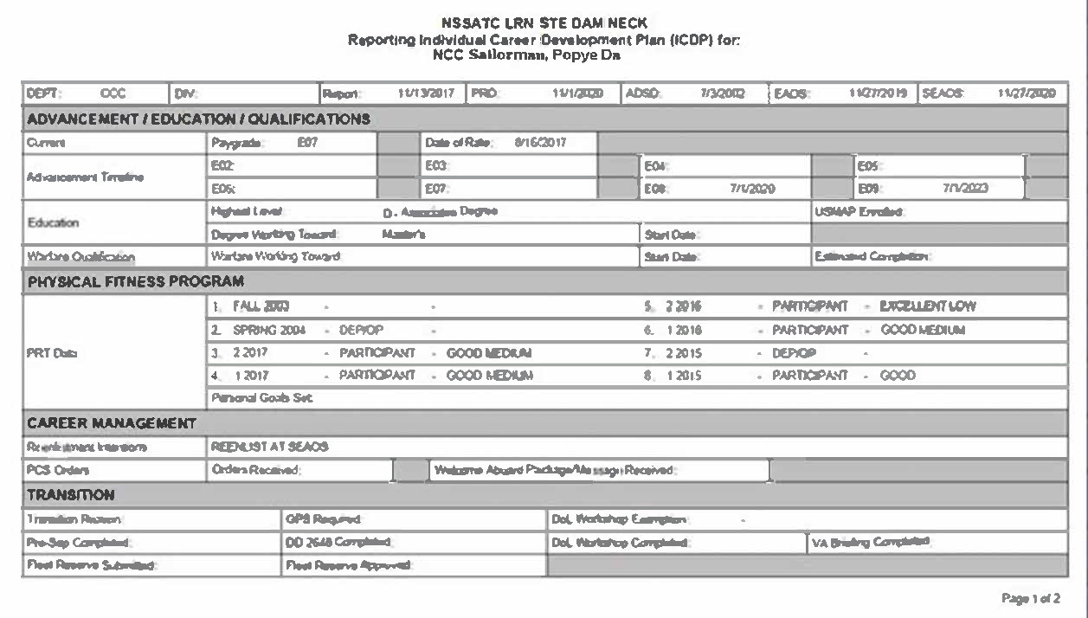
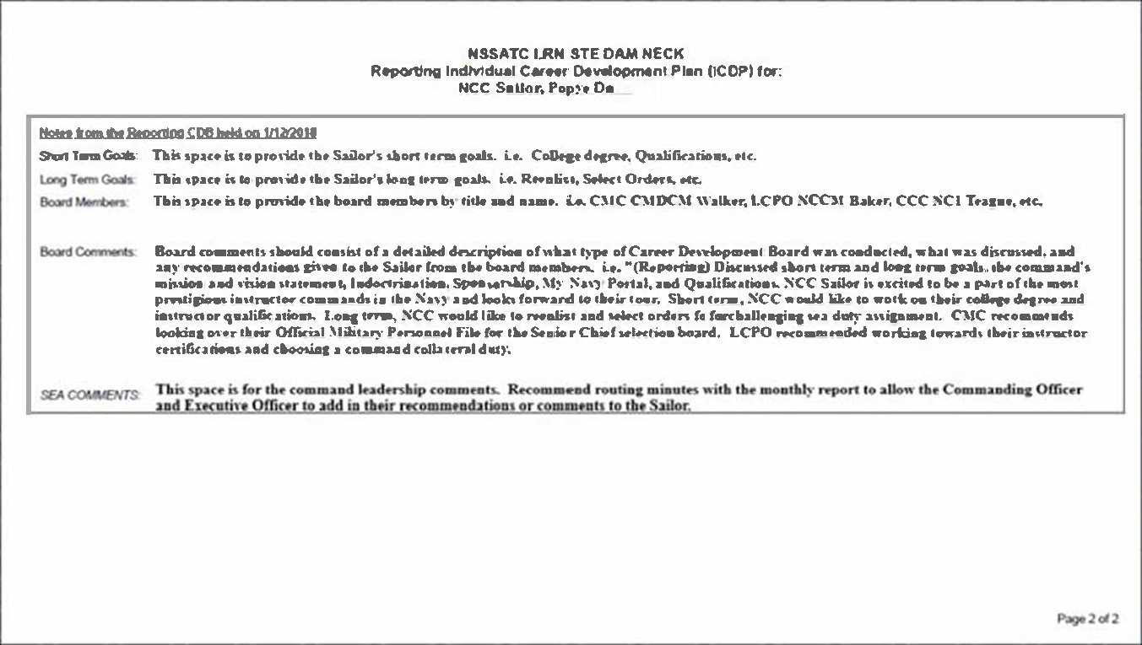
Career Development Board
Individual Career Development Plan (ICDP)
Developed to provide specific topics and guidance for each CDB throughout the lifecycle of the Sailor
Assists Sailors in establishing goals and milestones to chart a roadmap to success
Notes:
FACILITATOR GUIDE:
Updating the ICDP as a result of the CDB and providing a copy to the member allows Sailor to monitor and track their personal and professional development.

Slide 24
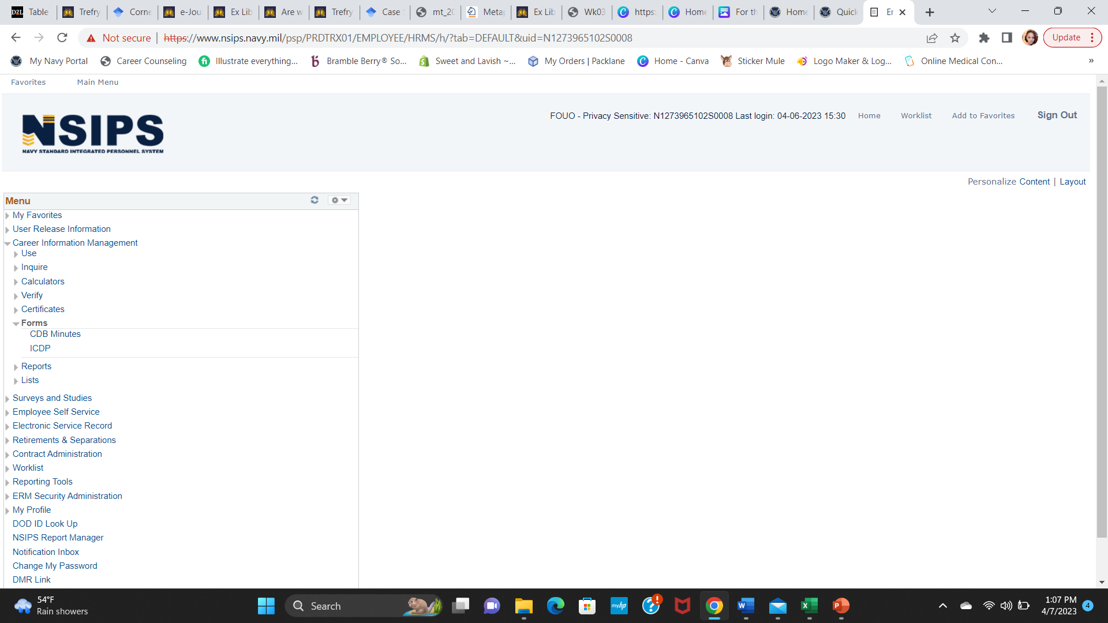
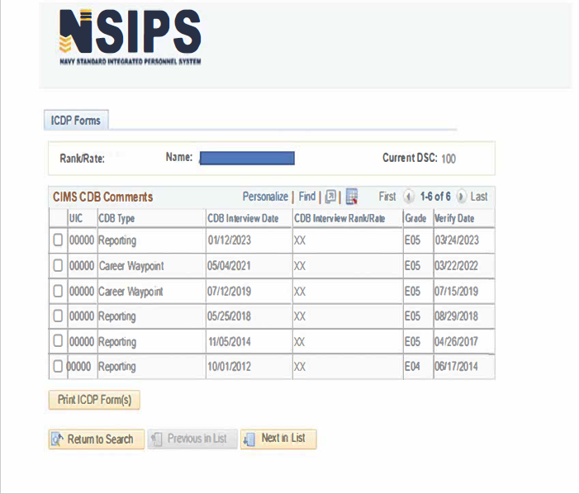
Career Development Board
NSIPS ICDP
Once you access the ICDP, choose the CDB timeframe
Notes:
FACILITATOR GUIDE:
Once a “pending“ CDB is created, and information from the previous CDB is loaded and saved, an Individual Career Development Plan (ICDP) form may be created to assist board members with the actual CDB.
Please note: You cannot access a newly reported Sailor ICDP unless and pending CDB is created.

Slide 25
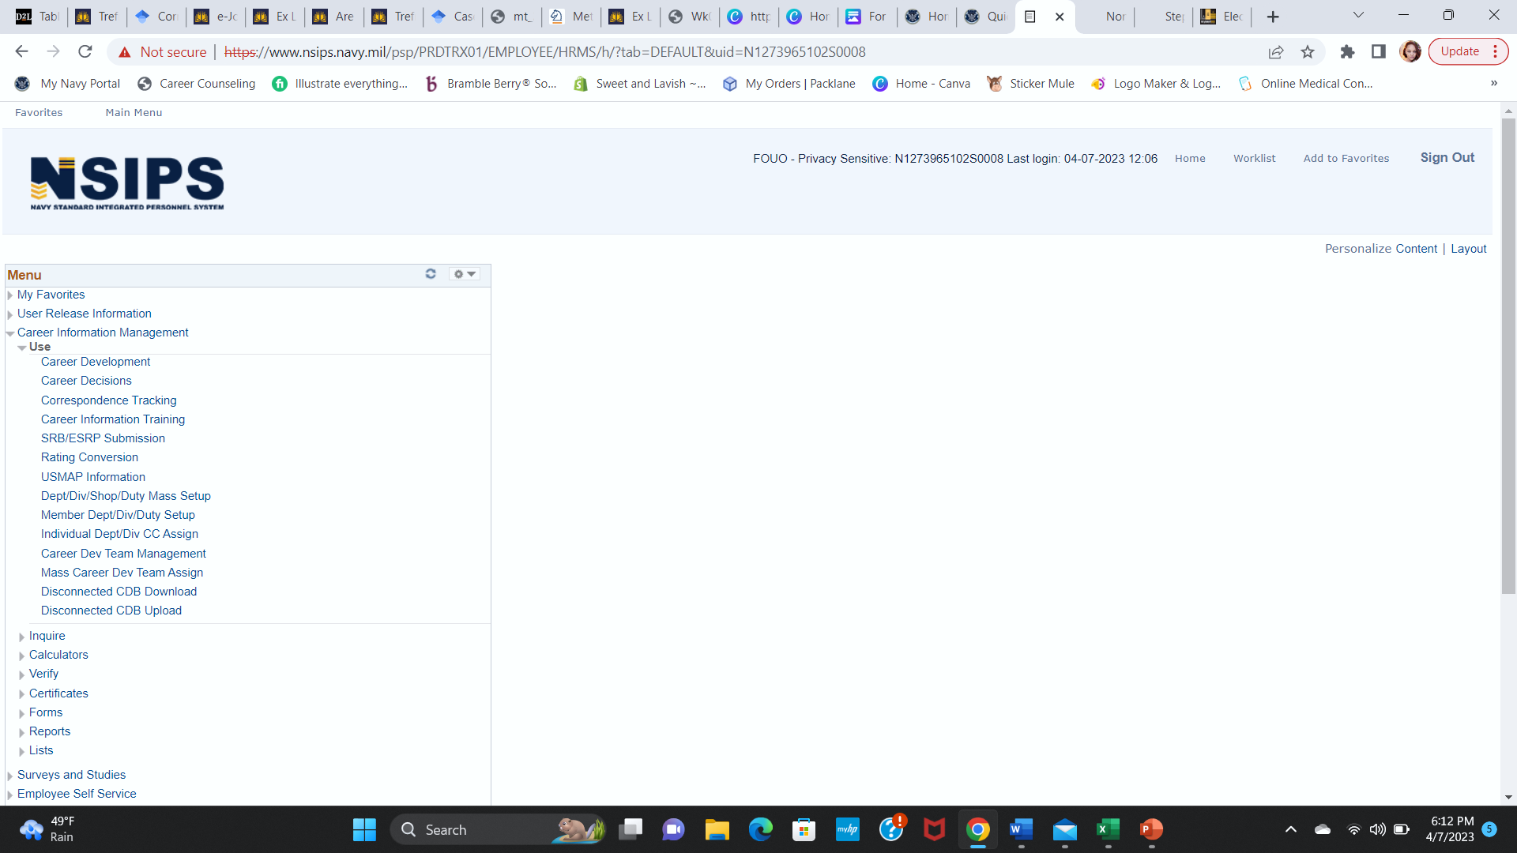
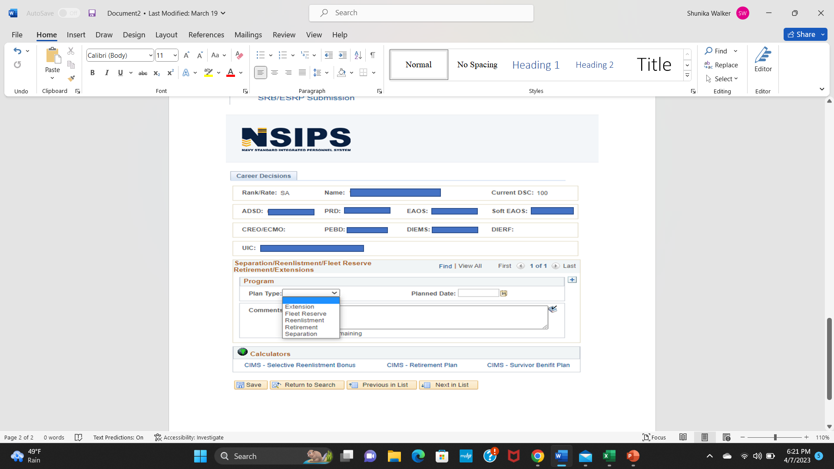
NISPS CAREER DECISION
Entry
Choose between the 5 options
This information will be updated on the ICDP and EAOS tracker
Notes:
FACILITATOR GUIDE:
Career Decisions - is used to enter a Sailor's significant Career Decisions into the system for reporting and tracking purposes. All data must be entered in order to save the career intention. If the information is unknown, then type in “unknown”. If the planned date is unknown, enter any date within the next 4 months of entry date.
This information will appear on the ICDP and EAOS tracker (career plan).
NOTE: This information is for tracking purposes ONLY and will not impact the Sailor in any way. Using this tool is a mandatory part of the CIPR process and should be updated monthly or as needed.

Slide 26
Summary and Review
In this lesson we discussed
    How CDBs encourage upward mobility, improve job satisfaction and enhance unit readiness
    CMCs and DLCPOs chairing CDBs
    S.M.A.R.T. Goals
    LaDR and Community Overview
    CIMS and Inputting CBDs
    How ICDPs assist in establishing goals for Sailors

Slide 27
Questions?

